Slide 1

Einstein Vision
Team Members:
Dhiraj Kumar Rouniyar
Dhrumil Kotadia
Notes:
Cover for a full photo background

Slide 2
Models Used
Detic - Object Detection
Mask-RCNN - Lane and Road Sign Detect​ion
YOLO3D - Vehicle Pose Estimation
I2L-MeshNet - Human Pose Detection
ZoeDepth - Monocular Depth Estimation
Yolov7 – Speed Hump detection

Slide 3
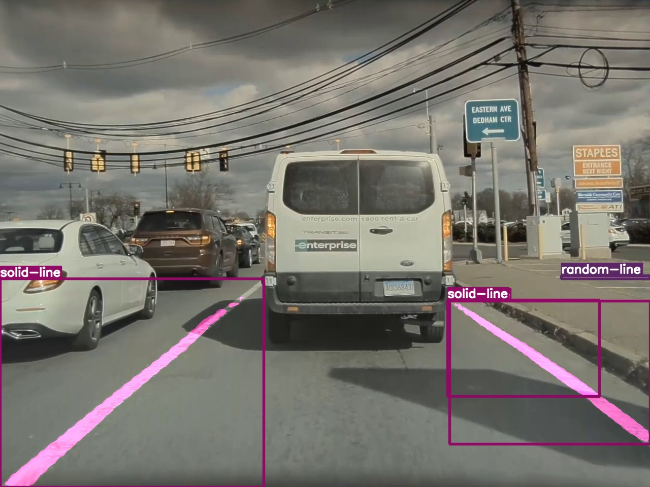
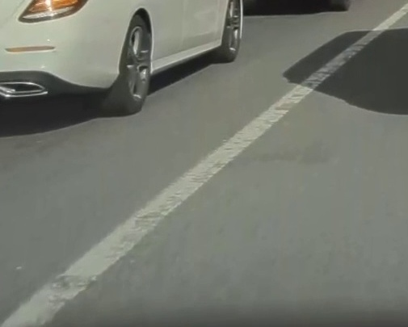
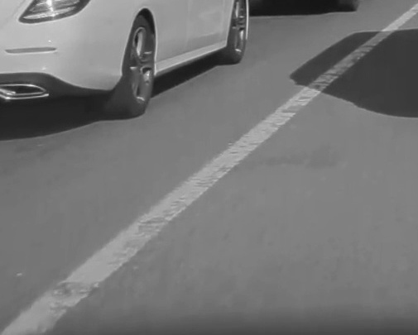

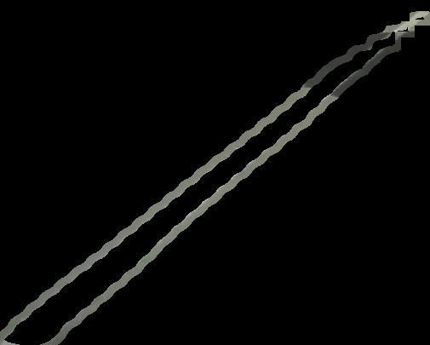
Lane Detection using Mask-RCNN

Slide 4
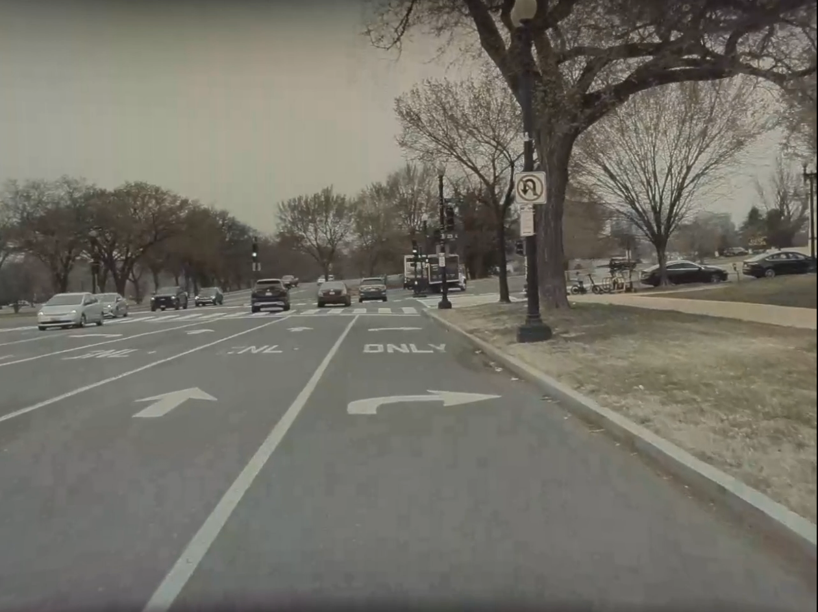
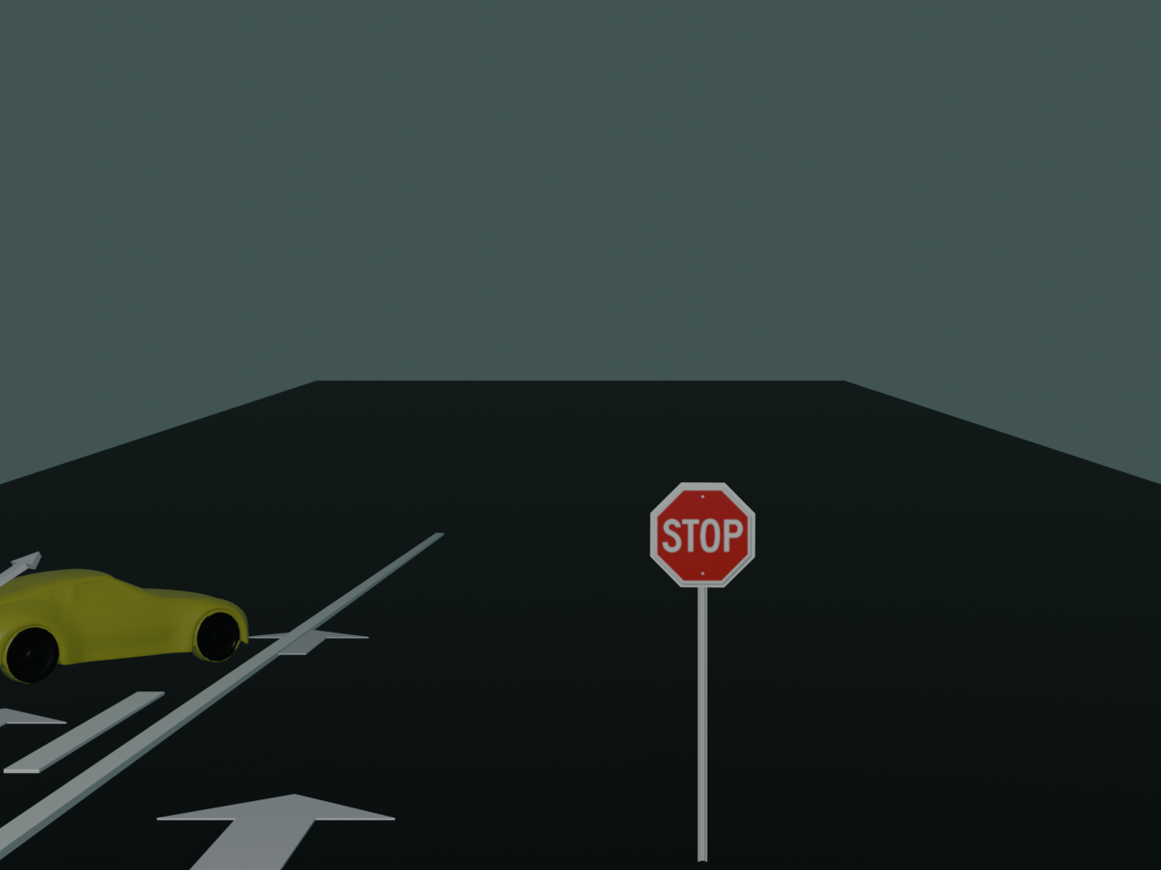
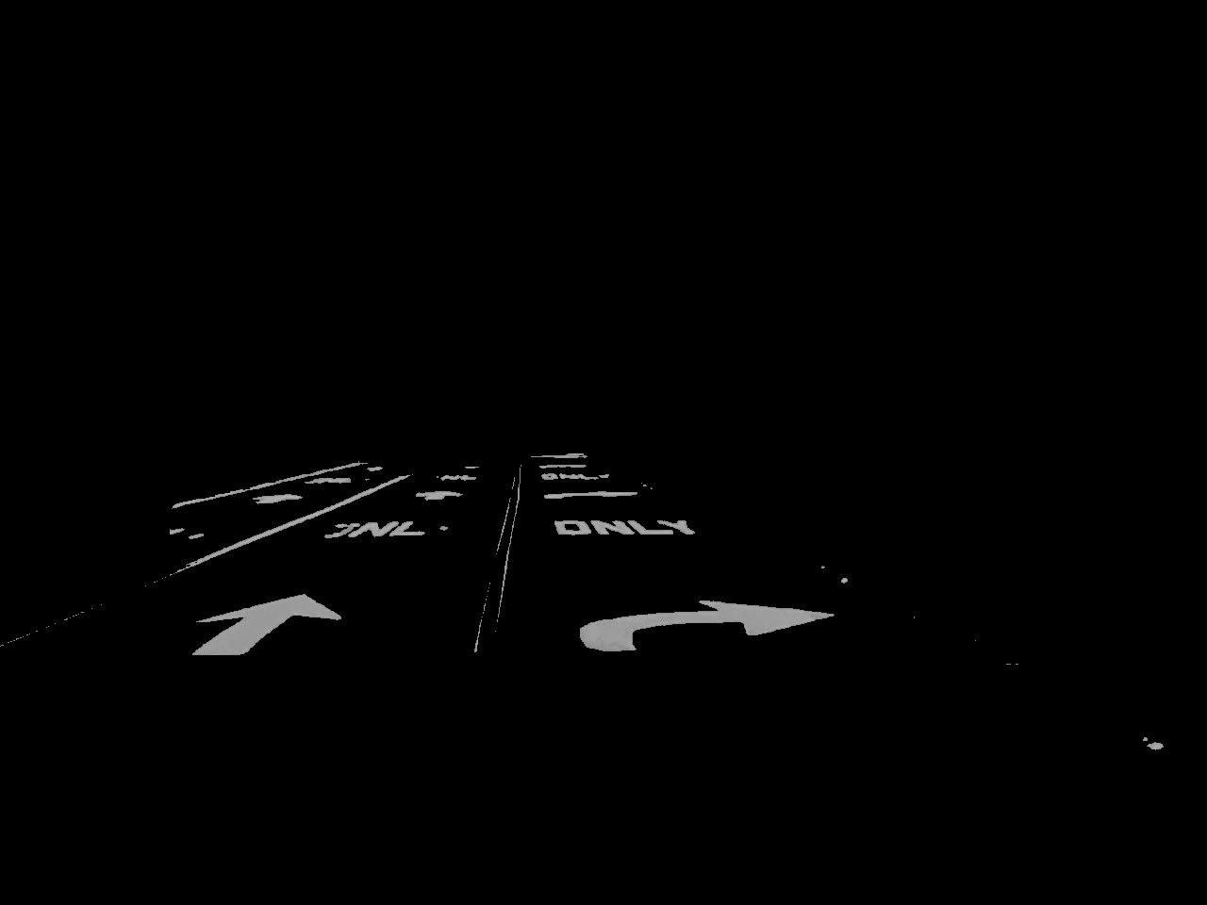

Road Sign Detection

Slide 5
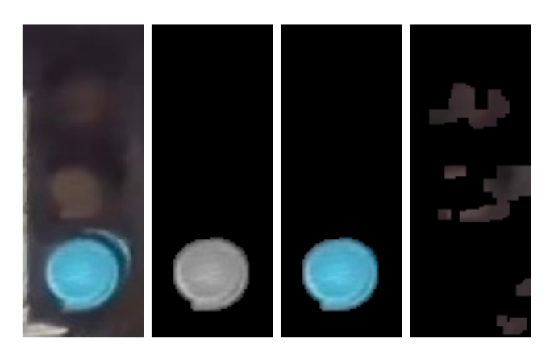
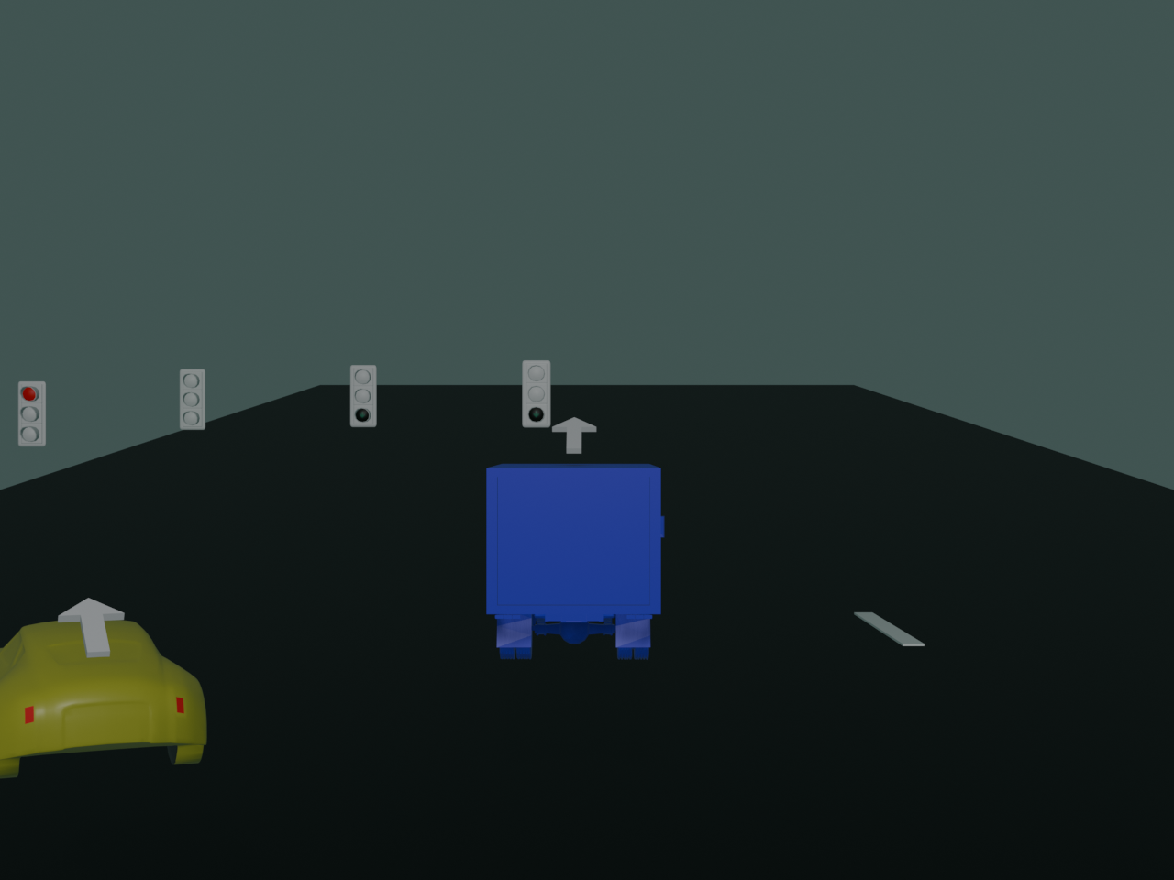
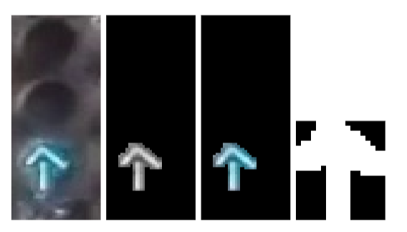
Traffic Light Color and Arrow Detection

Slide 6
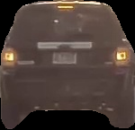
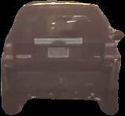
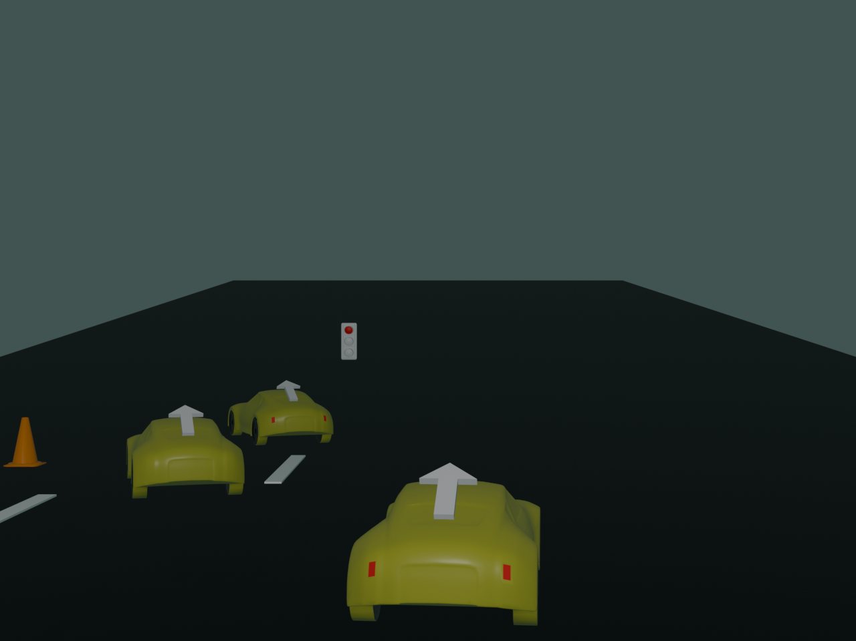
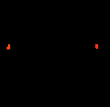

Vehicle Tail Light

Slide 7
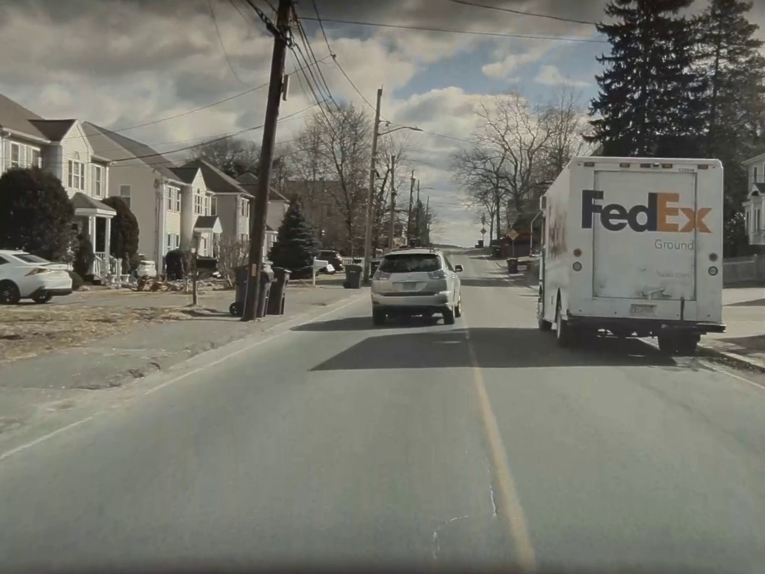
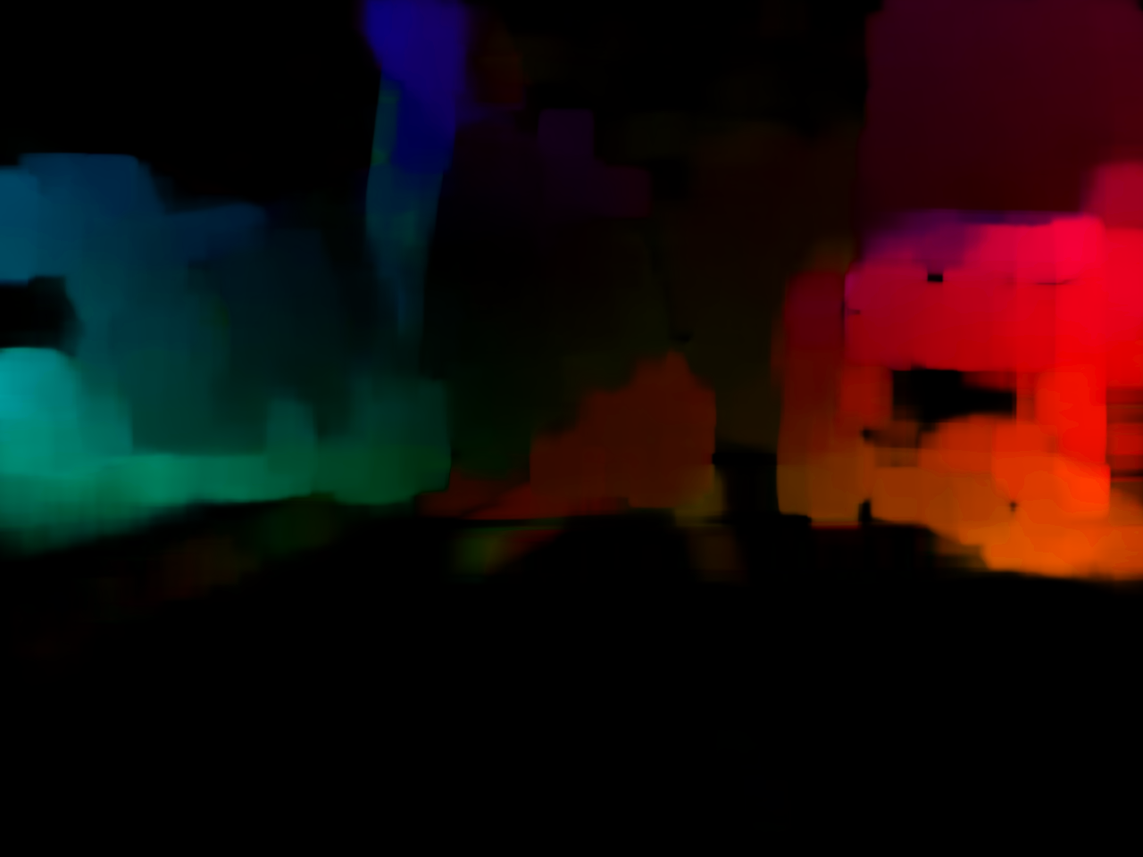
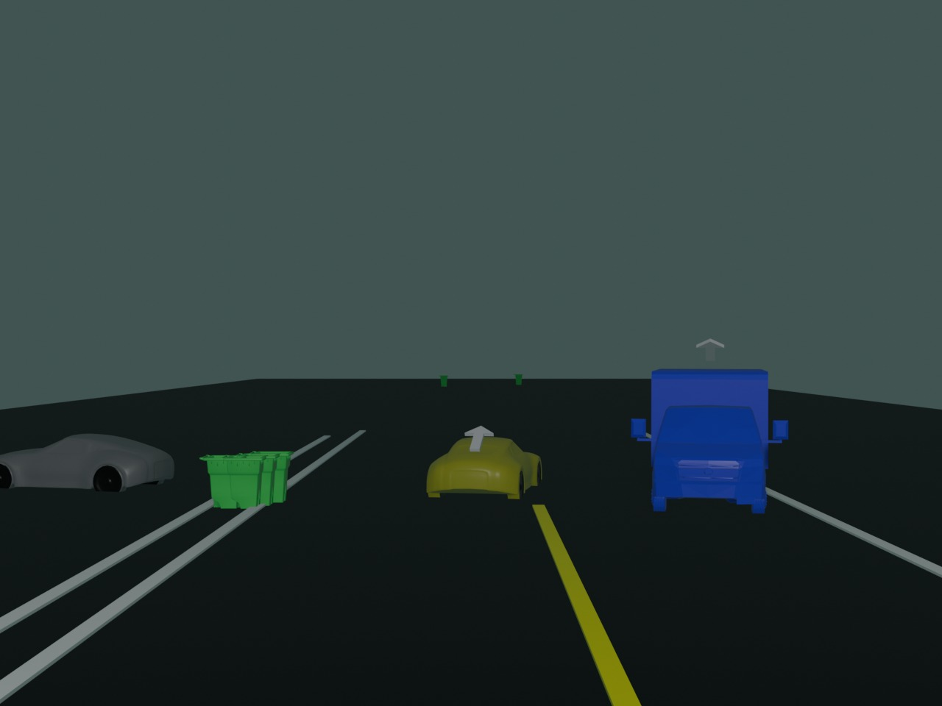
Optical Flow

Slide 8
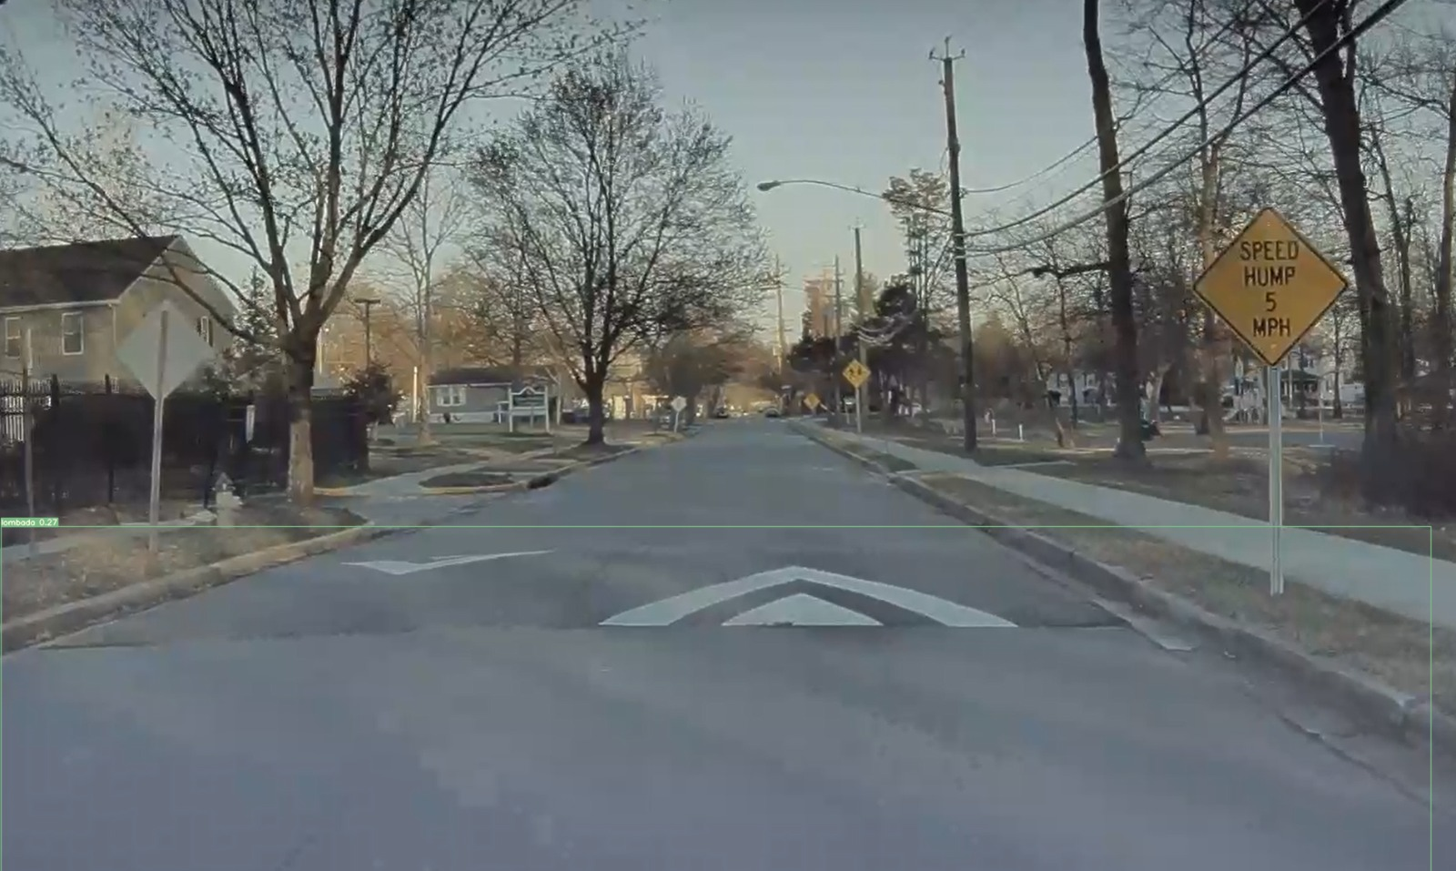
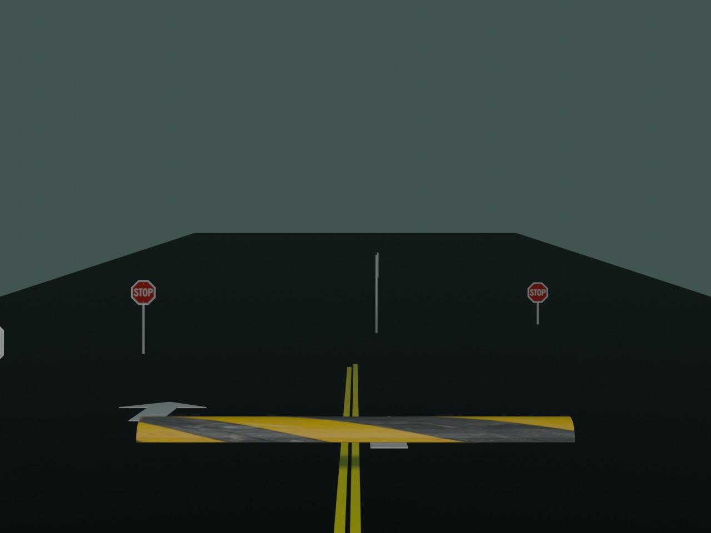
Speed Hump Detection

Slide 9
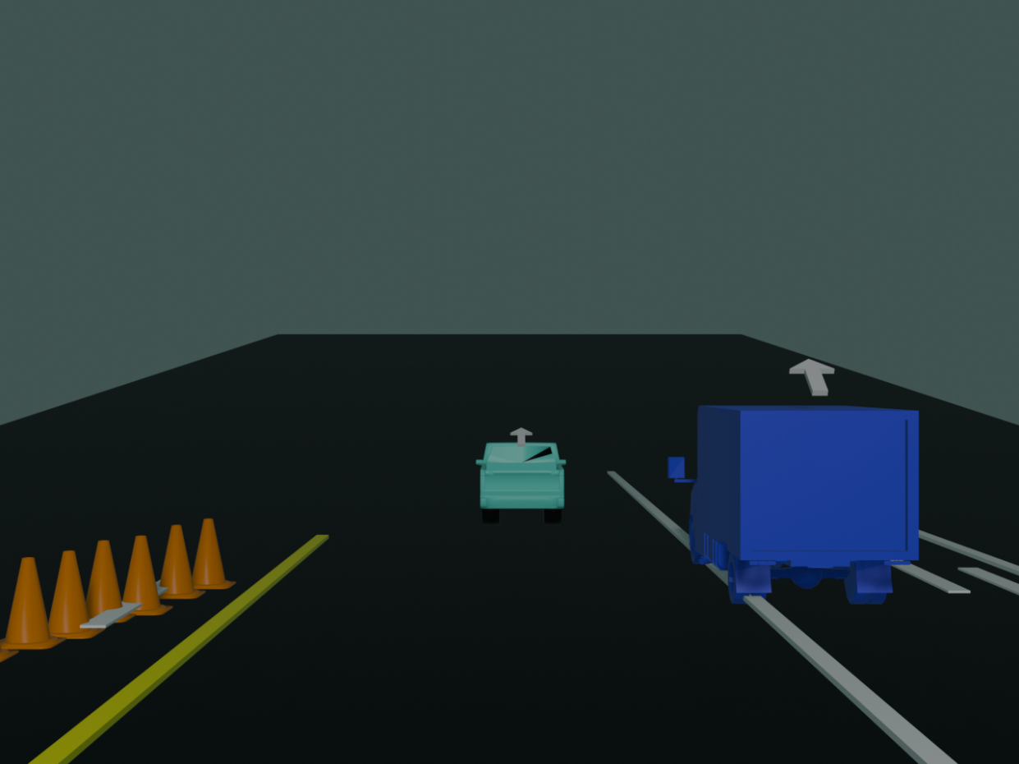
Thank you

